Slide 1


DATA ANALYSIS
An Exercise on UBER Bus-Trips (Feb-2021)

Slide 2

Agenda
What this report covers
01
The Exercise Topic
02
Exploring the Dataset
03
Cleaning the Data
04
Analysis & Insights

Slide 3

To Perform Data Cleansing & Analysis on a given dataset to derive valuable Insights bases on the following reports:
TpR:
Report on the average trips / rider and the distribution of riders with
different TpR buckets.
Report on the average trips / rider and the distribution of riders with
different TpR buckets for subscription trips.
Reliability:
Report on the fulfillment rates (% of trips that got completed) and the
cancellation rates by rider and by driver.
Report on the distribution of fulfillment rate by hour of day and by day of
Week.
Demand:
Report on the distribution in number of trips over the duration between the
request and the trip for both micro-scheduling and pre-scheduling
Requests.
Distribution of the number of trips by hour of day and by day of week.
Distribution of the number of trips by payment method.
Distribution of the vehicle utilization (trips / vehicle capacity) over the
different vehicle capacities.
Distribution of the walking distances by rider and by trip.
Distribution of trips by distance and by duration.
The Exercise Topic

Slide 4

Exploring The Dataset
Attributes of the Dataset:
● job_uuid: Unique Identifier for the trip
● client_uuid: Unique Identifier for the rider
● driver_uuid: Unique identifier for the driver
● vehicle_uuid: Unique identifier for the vehicle
● client_device: Type of client device
● is_subs_trip: Boolean indicating whether the trip is taken on a subscription
● request_type: Type of request (whether it is scheduled in advance or on the fly)
● status: Status of the trip (completed, canceled by rider, canceled by driver, etc.)
● request_date_time: Date and time of the request in local time
● begintrip_date_time:Date and time of the start of the trip in local time
● dropoff_date_time: Date and time of the end of the trip in local time
● trip_distance_miles: The distance of the trip in miles
● payment_method: The method of payment for the trip (Cash, Mastercard, visa, etc.)
● pickup_walking_distance: The distance the rider walked to the pickup point in meters
● vehicle_capacity: The number of seats in the vehicle
● trip_date: The date of the trip
Dataset Format : .CSV File | (10,000 rows & 16 Columns)

Slide 5
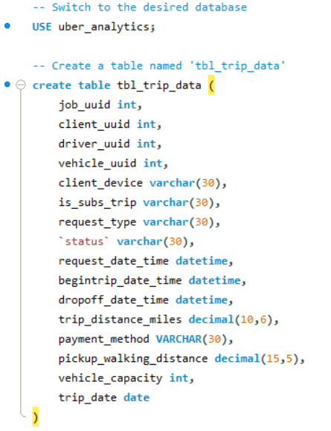
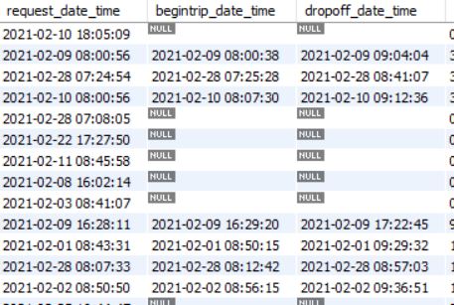
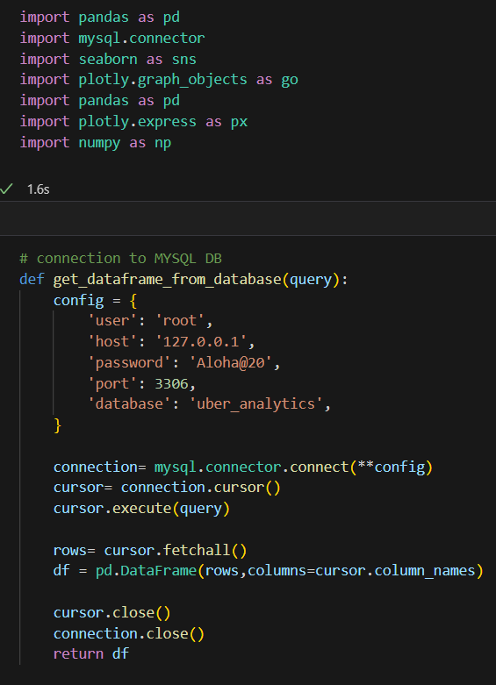


Data Cleansing
Initially, the Dataset was viewed using MS Excel.
It was then imported onto an RDBMS – MYSQL.
It was found that the Dataset contained NULL or
Missing values.
The missing values were handled during the Analysis process using SQL Query and Python Code for every report.

Slide 6
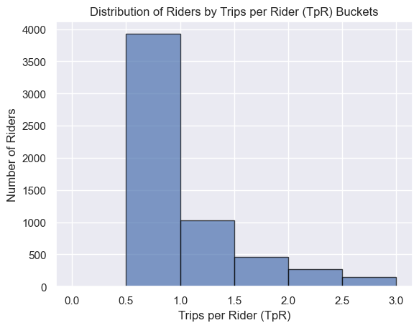
Analysis & Insights: TpR (Trips per Rider)
As per analysis, the Average Tpr Value was found to be 1.68.
A Tpr value greater than 1 suggests that riders are using the Uber Bus service more than once. In this case, the average value of 1.68 indicates that, on average, riders are using the service for almost two trips.
The Visual:
The graph shows that nearly 40% of customers are falling within the Tpr range of 0.5 to 1.0 for Uber Bus Trips, this information provides further insights into the distribution of rider behavior and usage patterns.
Insights:
Occasional Use: A significant proportion of customers (around 40%) use Uber Bus for single trips, showing occasional or exploratory usage.
Upselling Opportunity: Targeting promotions or incentives could convert occasional riders into more frequent users, boosting Tpr values.
Segmentation Insights: Analysis of Tpr distribution helps identify rider characteristics and preferences for tailored marketing strategies.
Addressing Barriers: Understanding why occasional riders use the service infrequently can guide improvements for better retention.
Customization Potential: Introducing options like flexible pricing or single-ride passes could accommodate varied rider needs.

Slide 7
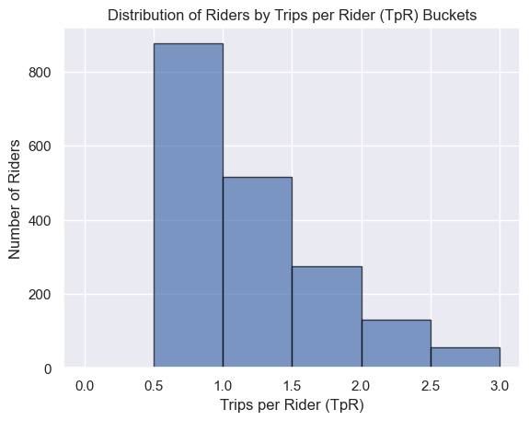
Analysis & Insights: TpR (Trips per Rider)
Subscription Trips
As per analysis, the Average Tpr Value was found to be 1.99.
The Tpr (Trips per Rider) value of 1.99 for subscription trips indicates that, on average, riders who are subscribed to a service took approximately 1.99 i.e 2 trips during the analyzed period. The changes in the bucket ranges provide valuable insights into rider behavior and usage patterns.
The Visual:
The distribution of riders reveals a notable discrepancy, with a larger proportion gravitating towards the 0.5-1 Tpr bucket range—indicating intermittent use—while a smaller segment falls within the 2.5-3 range, suggesting a group of more engaged riders who use the service more frequently.
Insights:
Higher Engagement: Tpr of 1.99 for subscriptions indicates increased rider involvement.
Incentivized Usage: Shift from 800 to 50 clients in Tpr buckets implies successful subscription encouragement for more consistent usage.
Loyalty and Frequency: Subscription impact reflected in fewer clients but higher Tpr range, highlighting loyalty and increased usage.
Strategy Validation: Tpr shift validates effective engagement strategies through subscriptions.

Slide 8

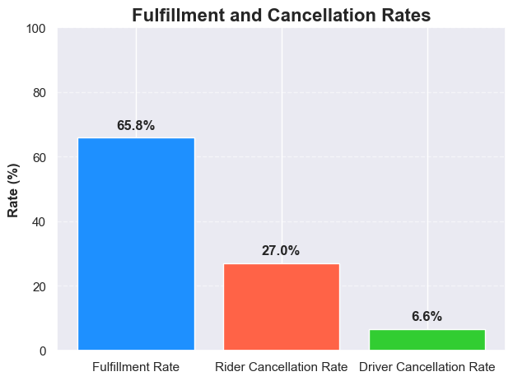
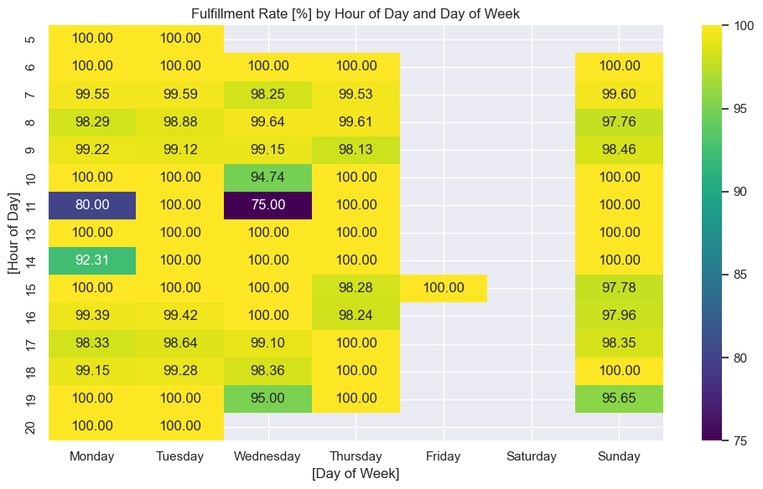
Analysis & Insights: Reliability
Fulfillment Rate (65.84%): Two-thirds of trip requests are successfully completed, indicating efficient supply-demand matching.
Rider Cancellation Rate (27.00%): High rider cancellations suggest potential issues in meeting expectations and ride matching.
Driver Cancellation Rate (6.60%): Low driver cancellations reflect good commitment and effective dispatch management.
Heatmap Analysis : It is observed from the visual that the % Fulfillment Rate is at a steady 100% on most days, dipping to around 80% on Monday & 75% on Wednesday @ 11:00 Hours.

Slide 9
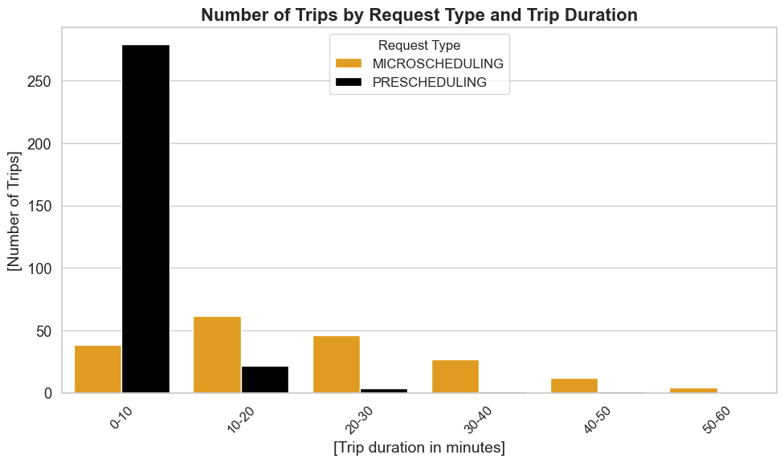
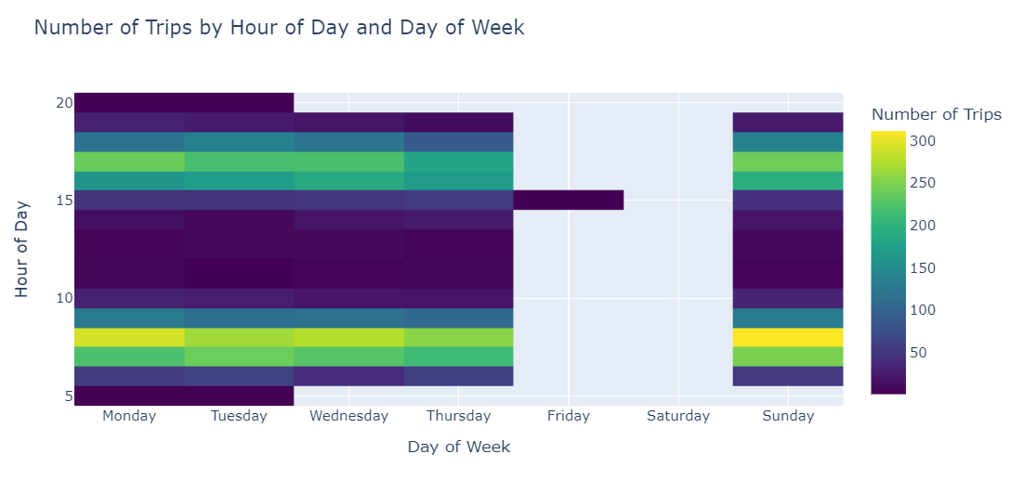
Analysis & Insights: Demand
Number of trips by Request Type, Hours Of Day, and Day of Week.
Insights:
Insights:
The distribution of trips based on microscheduling and prescheduling duration showed that the majority of clients scheduling trips lasting up to 10 minutes preferred prescheduling. In contrast, for trips lasting between 10-60 minutes, clients tended to book rides in real-time, suggesting a preference for on-the-fly bookings.
The distribution of trips by hour of day and day of the week indicated consistent activity throughout most days, except for Friday and Saturday, likely due to the weekend. Notably, peak demand occurred at 07:00, 8:00, 16:00, 17:00, and 18:00 hours, aligning with typical office timings, suggesting commuter usage.

Slide 10
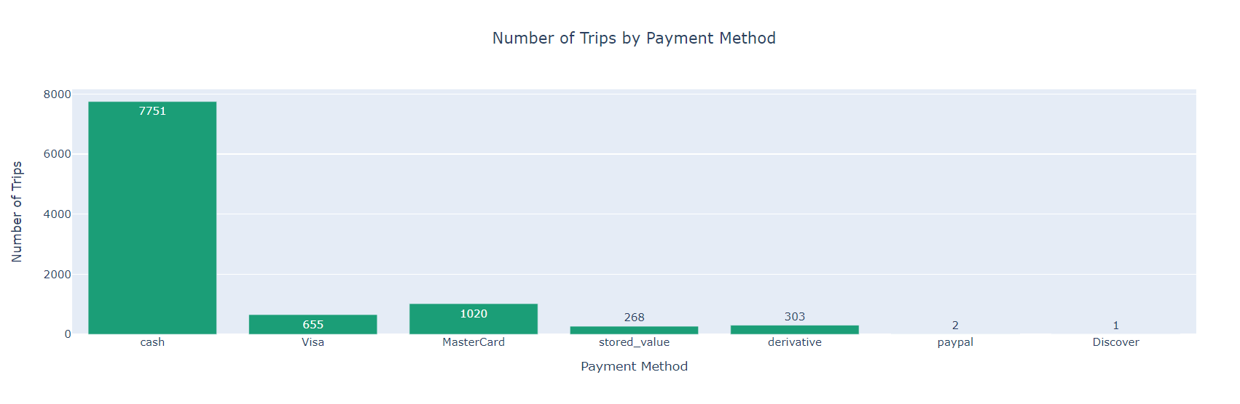
Analysis & Insights: Demand
Clients predominantly favored cash over other payment modes, with around 8000 opting for cash and approximately 1000 choosing Mastercard, while Paypal and Discover saw limited usage.
Trips vs Payment Method
Cash preference aligns with convenience and familiarity.
Mastercard usage indicates comfort with digital payments.
Lack of preference for Paypal and Discover highlights potential misalignment or low adoption.
Payment diversity impacts marketing and customer experience strategies.
Convenience of cash underlines the need for varied payment options.

Slide 11
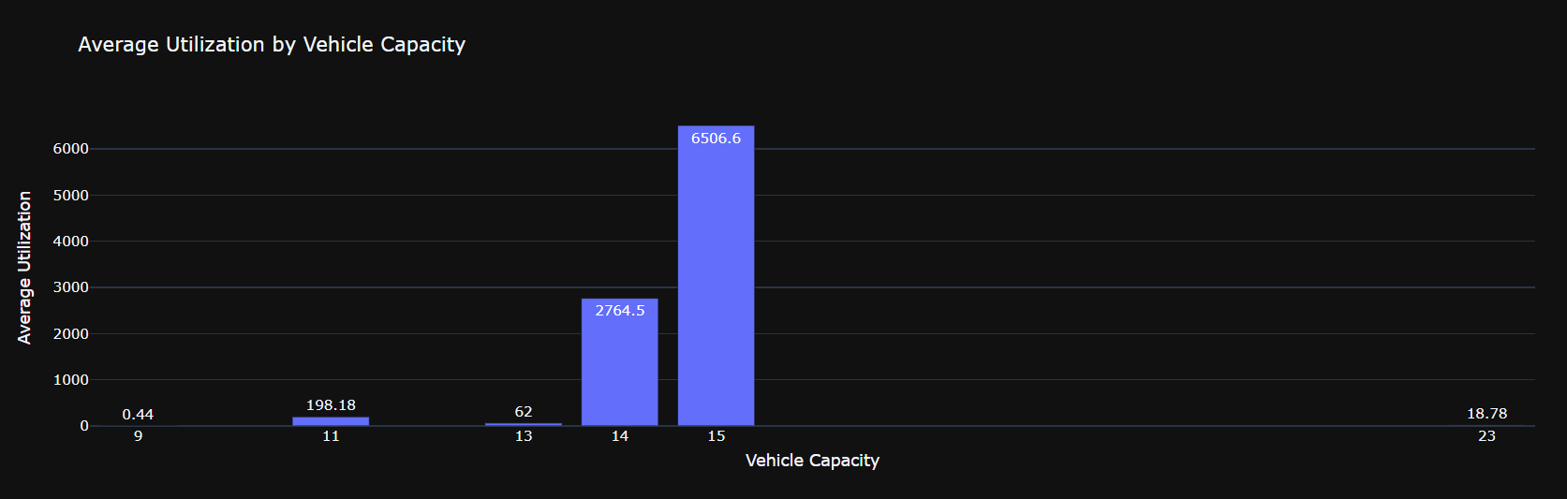
Analysis & Insights: Demand
Average Utilization by Vehicle Capacity.
Insights From the Visual:
Analysis of vehicle utilization reveals a preference for 14 and 15-seat buses among clients.
These bus sizes are likely favored due to their availability during peak demand periods.
Buses with 14 and 15 seats strike a balance between capacity and maneuverability.
Optimal deployment of these buses can enhance resource allocation and customer satisfaction.

Slide 12
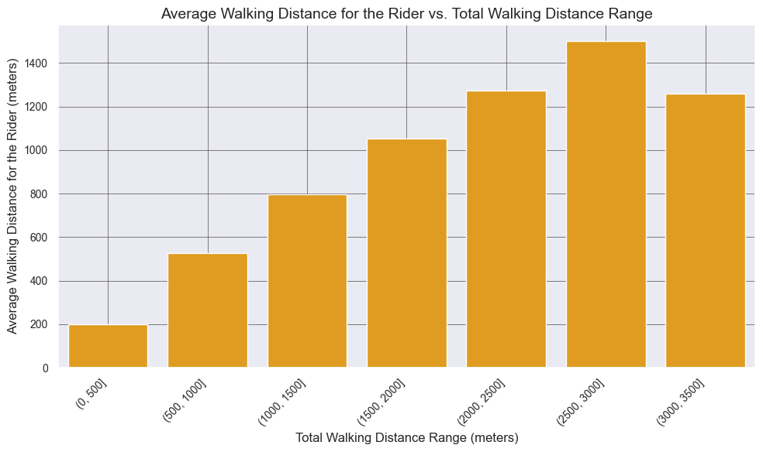
Analysis & Insights: Demand
Walking distance ranges against the Average Walking Distance for the rider.
Insights from the visual:
Data Analysis Confirmation: In-depth data analysis confirmed trends in clients' walking distances to pick up spots.
Walking Distance Gradient: Direct link observed between distance covered and average walking distance.
Longer Distance, Greater Walk: Clients covering 2500-3000 meters had slightly over 1400 meters average walk.
Implications of Longer Walks: Longer walks indicated pickups in less accessible areas.
Walking Distance for Shorter Trips: Shorter trips (up to 500 meters) resulted in a lower average walking distance of 200 meters.
Accessibility and Proximity: Proximity to pickup points related to shorter average walking distances.
Operational Optimization: Insights suggest adjusting pickup locations for improved accessibility and customer experiences.

Slide 13
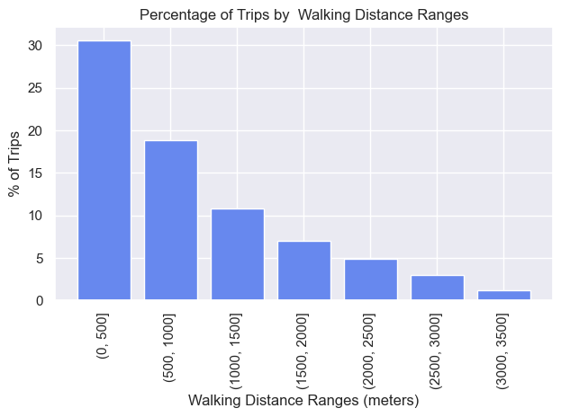
Analysis & Insights: Demand
Percentage of Trips against the Walking Distance Ranges for the rider.
Insights from the visual:
The visual representation reveals that the majority of trips, accounting for approximately 30%, were associated with clients who walked up to a distance of 500 meters to reach the pickup locations.
Subsequently, around 18% of trips fell within the distance range of 500 to 1000 meters, followed by 11% for distances ranging from 1000 to 1500 meters.
A noticeable pattern emerges where the percentage of trips progressively decreases as the walking distances extend.
Additionally, a small fraction of trips, about 1%, encompassed clients traveling distances between 3000 and 3500 meters to reach the pickup points.
Actionable Insights:
Optimize Pickup Points: Strategically position pickup points within high foot traffic areas for better accessibility.
Enhance Mid-Range Convenience: Improve convenience for distances between 500 and 1500 meters with clear directions or amenities.
Incentivize Longer Walks: Address lower percentages beyond 1500 meters with incentives or accessible pickup points.
Analyze Long-Distance Trips: Investigate factors driving the 1% of trips exceeding 3000 meters.
Dynamic Pickup Strategies: Consider adjusting pickup frequency based on walking distance for efficient service.

Slide 14
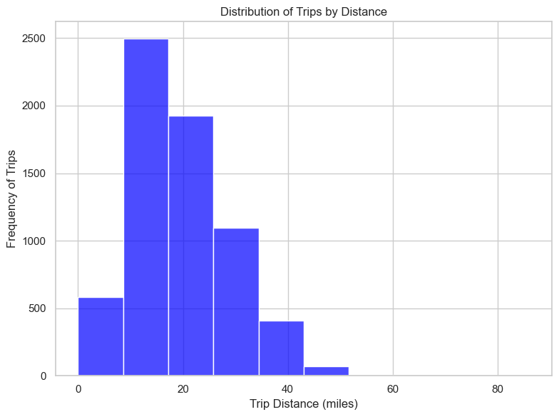
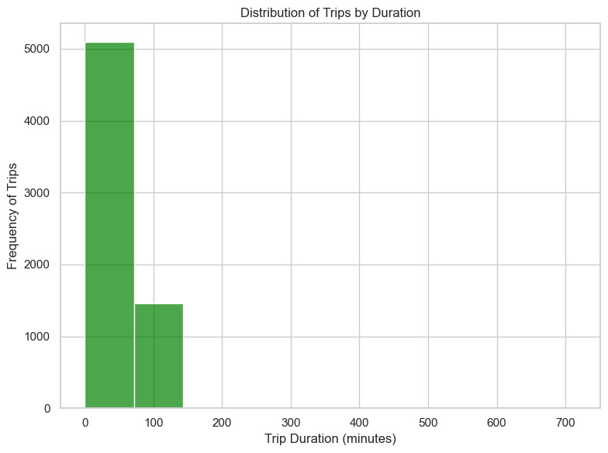
Analysis & Insights: Demand
Trip Distribution by Distance highlights:
Popular Range: High trip concentration (2500 trips) within 10-18 mile range reflects a common travel preference.
Moderate Demand: Around 1800 trips in 18-25 mile range suggest moderate interest in longer distances.
Long-Distance Frequency: Fewer trips (42-50 miles) indicate lower demand for extended rides.
Trip Distribution by Duration highlights:
Peak Demand Window: High trip volume (5000 trips) in 25-75 minutes range reflects strong demand for mid-length journeys, likely encompassing daily commutes and short outings.
Interest in Longer Travel: About 1500 trips lasting 75-140 minutes indicate significant interest in extended journeys, which could include longer commutes or leisure trips.
Service Planning Strategy: Insights inform service planning for ensuring availability during popular 25-75-minute windows and catering to diverse travel needs.

Slide 15




Thank you!
Feel free to reach out if you have any questions.
+91-993-411-2010
rohansahay21@gmail.com
www.linkedin.com/in/rohansahay199269

